Slide 1
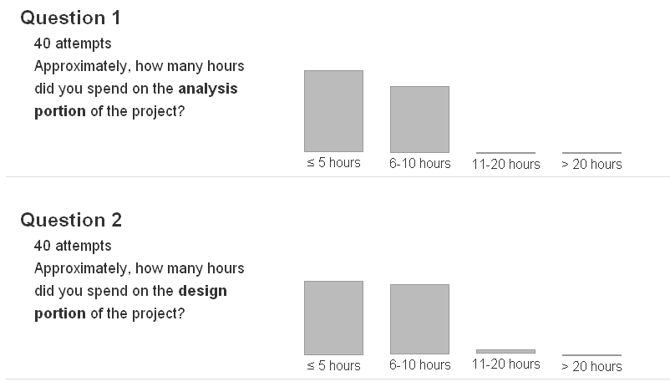
Project 1 – Spring 2012
Notes:
40 students. 2 minutes.
Q1: 55%, 45%, 0%, 0%
Q2: 50%, 47%, 2%, 0%

Slide 2
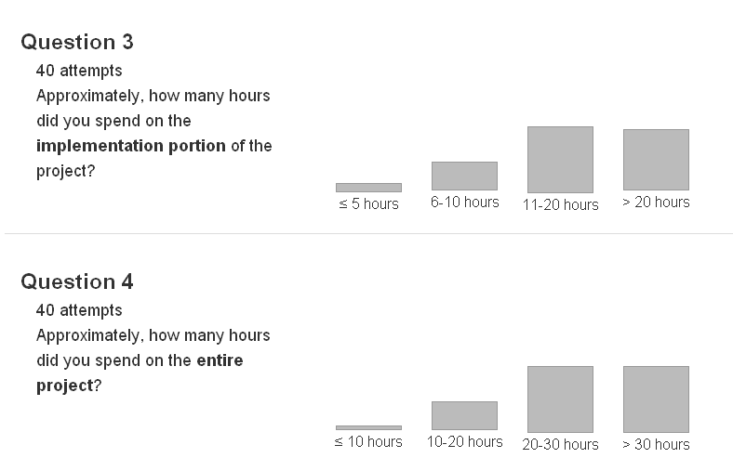
Project 1 – Spring 2012
Notes:
Q3: 5%, 17%, 40%, 37%
Q4: 2%, 17%, 40%, 40%

Slide 3
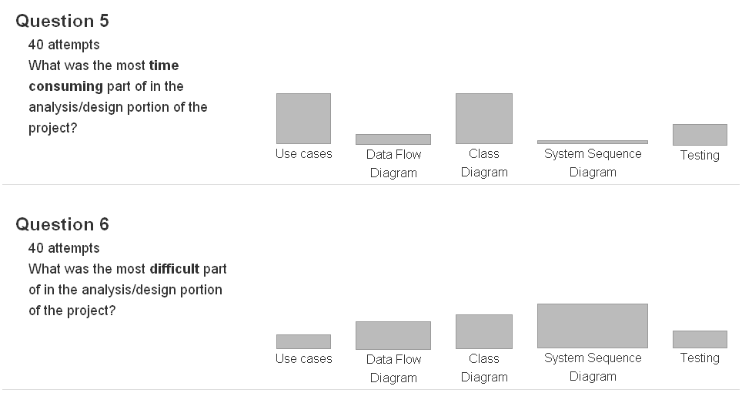
Project 1 – Spring 2012
Notes:
Q5: 37%, 7%, 37%, 2%, 15%
Q6: 10%, 20%, 25%, 32%, 12%
Suggestion: Highlight system sequence diagram.

Slide 4
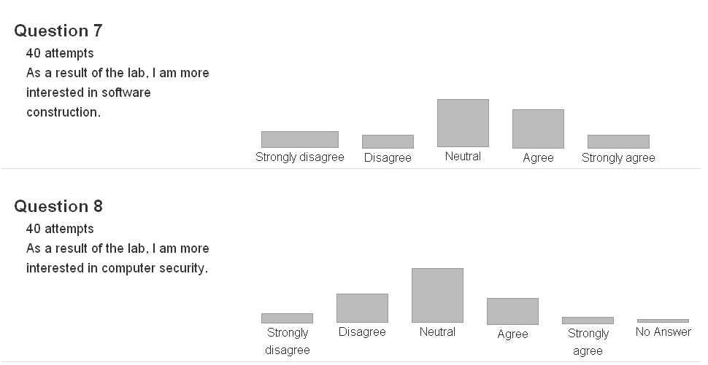
Project 1 – Spring 2012
Notes:
Q7: 12%, 10%, 37%, 30%, 10%
Q8: 7%, 22%, 42%, 20%, 5%, 2%
25% either strongly agree or agree.

